Slide 1
Information Capture and Management with Document Navigator & Filestar
Presenter: Brett Lewis
Design Consultant – Indirect Partner Channel
Co-Presenter: Philip John
Category Manager – Office Products
Notes:
Brett Lewis Contact Details;
Design Consultant (Pre-Sales)
Indirect Partner Channel
brett.lewis@konicaminolta.co.uk
07860 753431

Slide 2
Agenda
Introduction
Introduction to Document Capture & Management
Introduction to Document Navigator
Introduction to Filestar
4 Step Sales Process
Benefits
Questions

Slide 3
THE CURRENT SITUATION IN MANY OFFICES
DOCUMENTS HAVE TO BE SCANNED, PROCESSED AND DELIVERED TO ONE OR MORE DESTINATIONS
LOST PRODUCTIVITY
LOSS OF TIME
Notes:
As organizations begin their Digital Transformation efforts, their feedback shows they are focusing on three key areas for improvement:
IT processes and their modernization (58%, to give them more business agility)
Information Governance (42%, to make their information assets more findable, accurate, and accessible)
Customer Experiences (39%, to increase value to customers and head off potential digital disruptors).

Slide 4
THE CURRENT SITUATION IN MANY OFFICES
ALL OF THESE ADMINISTRATIVE TASKS INVOLVE
A LOT OF MANUAL INTERVENTION FOR EACH TASK
DATA CHAOS
LOSS OF MONEY
Notes:
A rising tide of information chaos and confusion imperils these desired Digital Transformation journeys.
The volume,
The velocity,
And the variety of information that most organizations need to manage, store, and protect now exceeds their ability to even marginally keep pace with big content challenges.
This rising tide of information chaos and confusion is creating a demand for new information management practices that extend beyond traditional Enterprise Content Management. AIIM calls this Intelligent Information Management (IIM).
IIM provides the following key capabilities:
CONTENT SERVICES – a flexible and modular approach that utilizes content and information wherever and whenever it is needed, independent of the legacy ECM preoccupation of where it is stored;
PROCESS SERVICES – process tools that can be delivered with the simplicity of an app, but within a framework that allows the business to remain in control; and
ANALYTICS SERVICES – automated tools to prepare ALL of its information – both structured and unstructured – for machine learning.
I use the term ‘Services’ deliberately, because an organisation must be able to link the solution(s) capabilities together to meet the demands of an organisations DX requirements.
The following slides will map some of Document Navigator’s capabilities against each of the these three services

Slide 5
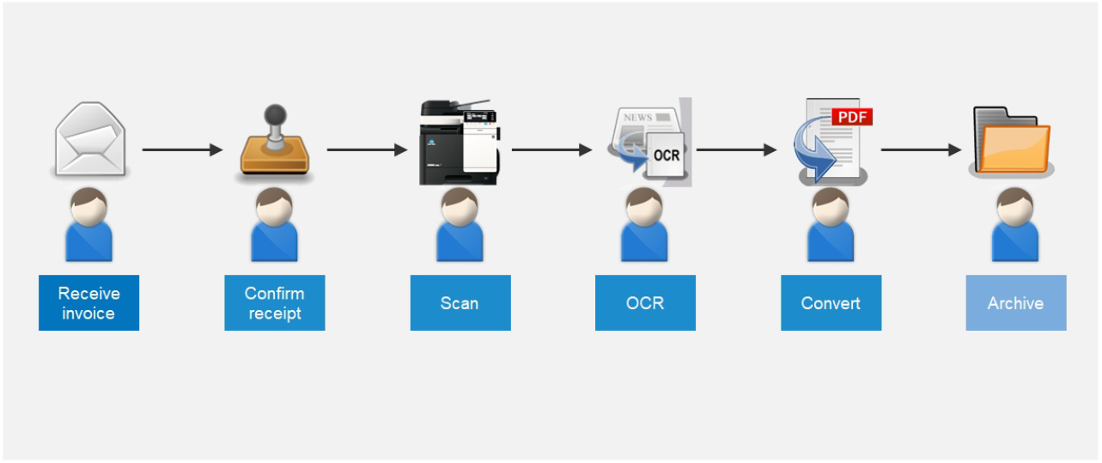
WORKFLOWS AS PART OF DAILY BUSINESS
AN EXAMPLE
Manual Workflow
Notes:
This slide is just showing a basic manual process that a typical end user will go through to manage the receipt of a document coming into the business, to review the content of the document and approve this content (in this example it is an invoice) to then scan the document and convert to a searchable format to then manually name the document and then browse a folder structure to store the scanned document.
An alternative to a fileserver to store the document to could be for example a OneDrive or Google Drive folder structure or a SharePoint Site>Library>Folder structure.

Slide 6
THE CURRENT SITUATION IN MANY OFFICES
,,Offering Intelligent Document Capture, Processing, Delivery, & Management, Where Document Navigator & Filestar Provides Seamless Electronic Workflows For Paper-based Documents. The Simple, Flexible Capture & Content Management Solution Provides Document-based Processes With Ease And Absolute Reliability, Letting Office Workers Concentrate On There Primary Day to Day Business Tasks Essential To Their Business.”
Notes:
Offering Intelligent Document Capture, Processing, Delivery, & Management,
Where Document Navigator & Filestar Provides Seamless Electronic Workflows For Paper-based Documents.
The Simple, Flexible Capture & Content Management Solution Provides Document-based Processes With Ease And Absolute Reliability, Letting Office Workers Concentrate On There Primary Day to Day Business Tasks Essential To Their Business.”

Slide 7
Document navigator
Introduction to document navigator v5
Notes:
The following section of this presentation I will discuss how the Document Navigator Features and Functions map to the DX processes that I talked about in previous slides

Slide 8
Document navigator
There are two Editions that can be purchased
Document Navigator Essentials Edition
Document Navigator Server (AKA Enterprise) Edition
Notes:
There are two editions of Document Navigator;
Document Navigator Essentials (Entry Level) Edition
Includes 1 x Embedded MFD Client
Includes 1 x Desktop Client
Includes WatchFolder Monitoring
Includes Zonal OCR, Smart OCR, and Barcode Engines
Includes Cloud Connectors (1) Fileserver, (2) Email, (3) Google Drive, (4) OneDrive, (5) SharePoint, (6) Dropbox
Default OCR Engine is Omnipage, but Includes ABBYY FineReader Engine (5K Pages Processed Per Month)
Includes 1st Years Maintenance and Support
NO options to add on additional modules with exception to add additional MFD and Desktop Clients. But Document Navigator Essentials can be upgraded to the Server (AKA Enterprise) Edition
Document Navigator Server Edition (AKA Enterprise)
Includes 1 x Embedded MFD Client
Includes 1 x Desktop Client
Includes WatchFolder Monitoring and Email Mailbox Monitoring
Includes Zonal OCR, Smart OCR, and Barcode Engines
Includes Cloud Connectors (1) Fileserver, (2) Email, (3) Google Drive, (4) OneDrive, (5) SharePoint, (6) Dropbox
Default OCR Engine is Omnipage, but ABBYY FineReader can be purchased as an Add-on
Includes 1st Years Maintenance and Support
Includes Capture Workflow Triggers
OMR and ICR OCR Engines can be purchased as an Add-on
Print Client can be purchased as an Add-on
Scripting (VB or Java) can be developed to enhance the Document Capture workflows to add further logic to enable to workflow to be scaled up further
Verification Workflow module can be purchased as an Add-on for approval steps processes
Back Office Connectors can be purchased as an Add-on for storing documents into other back office systems

Slide 9
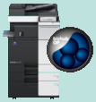
Document Navigator CAPTURE services
Document Navigator – Client > Server Application – 3 Step Process
Capture
Konica Minolta
Multifunctional Device
Process
Document Navigator Process Server
Store
SMB Fileshare
Notes:
The architecture of Document Navigator is built upon a Client > Server .NET Application where most services are based on web services and the application currently needs to be installed onto a dedicated (recommended) server or PC. The capture clients are typically all web services deployed to the MFD and just handle the dynamic communication between the MFD and Server to select the workflow, request responses to questions (assuming the workflow has questions) and trigger the device to scan the document and deliver the raw image to the server for further processing.
The server will receive the raw image and process the document based on the configured rules within the workflow design, and once completed will deliver the processed document as a file format which is typically a searchable PDF document (but can be other formats such as MS Word, MS Excel, TIFF, etc) through the output connector such as Microsoft SharePoint to store the document

Slide 10
Document Navigator
Supported Manufacturers
Notes:
Document Navigator supports a number of manufacturers MFDs, and partners are able to purchase those embedded clients if needed.
This is ideal for multi manufacturer fleet of devices installed on a customers network or for our partners that sell other brands.

Slide 11
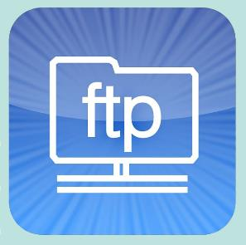
Document Navigator
Multi-Channel Capture
Interactive Capture Clients
Indirect Capture Clients
Notes:
Some of the Clients will require to be purchased.
Interactive Clients:
These are clients that have the ability to communicate bidirectionally to request information from the end user or for the user to perform lookups on systems to locate the information that they wish to tag the document with to identify the destination to store the document to and / or name the file.
Indirect Capture Clients:
These clients do not have the ability to perform a bidirectional communication and rely on the content of the document to contain the information to identify the destination to store the document and / or name the file.

Slide 12
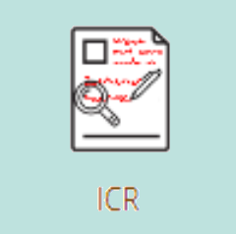
Document Navigator
Data Recognition & Extraction
Notes:
Date Recognition available within Document Navigator;
INCLUDED in Document Navigator: Barcode Recognition. This is the recommended best practice process as barcodes / QR codes are pretty bullet proof when it comes to reading the data. This is why retail and logistics utilise this technology compared to other recognition options.
INCLUDED in Document Navigator: Zone OCR (Optical Character Recognition) has the ability for the page to be processed to have predefined zones mapped to the document to then capture any machine printed text within the zone(s). This technology is not 100% proof as other factors can come into play such as poor document quality, poor design layout (lack of blank retail space around the text), issues with fonts not designed for OCR engines to be effective and page movement / skew during the scanning process. I base a 80% Capture Rate vs 20% Exception rate depending on the affects discussed previously, but this could be worse if the document contains all issues mentioned. If the customer is willing to work with you to mitigate those issues and has the power to have the layout of the document modified, then it is quite possible to get closer to 100%.
INCLUDED in Document Navigator: Smart OCR is a newer technology to Zonal OCR and is less sensitive to movement and skew of the document, as it first performs a full page search for a predefined string of characters as a reference, usually a word (for example Invoice No.), and when that reference has been found, the configuration tells the OCR engine to look to one of four directions (1) North, (2) East, (3) South, and (4) West of the reference to look for a specific string of characters. In this example the Invoice Number itself.
Additional Purchase Required: ICR Recognition (Intelligent Character Recognition) will look for “Hand Printed” (usually in black ink) characters rather then free hand text (no Doctors writing) and preferable each character contained in boxes. It will perform fairly well on unconstrained Hand Printed text, but their will be a need to proof read the extraction before committing the document to a storage location.
Additional Purchase Required: OMR Recognition (Optical Mark Recognition) is a technology typically used for lottery tickets, multichoice exam forms and survey forms. One use we tend to configure is to check a location on a document for a signature. The OMR engine cannot tell whether it is a signature, but it can identify if something has been added to the Signature panel or not. If nothing is found this can then notify a nominated end user that the document has not been signed and will place the document in query until resolved.

Slide 13
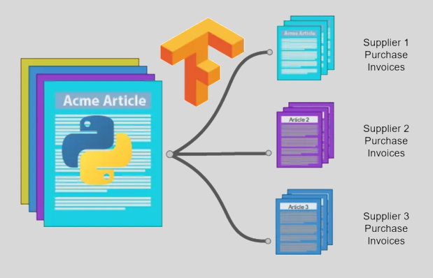
Document Navigator Recognition Service
Data Recognition & Extraction
Notes:
Data Recognition Engine / Freeform Engine
There are two types of data recognition engine dependent on whether or not the content layout is structured or not.
The standard recognition engine (additional purchase required) is looking for particular patterns within the structure of the document to identify the content.
The Freeform recognition engine (additional purchase required) is more advanced and is based on a template structure and typically used in purchase invoice workflows, but is not just limited to those workflows.
The benefit of this engine is it is a precursor to the other OCR / Barcode engines where Freeform is used to work with a batch of documents (all mixed content) to analyse the document and process each different document layout to its own particular workflow process where additional OCR / Barcode recognition can take place specific to that particular layout type.

Slide 14
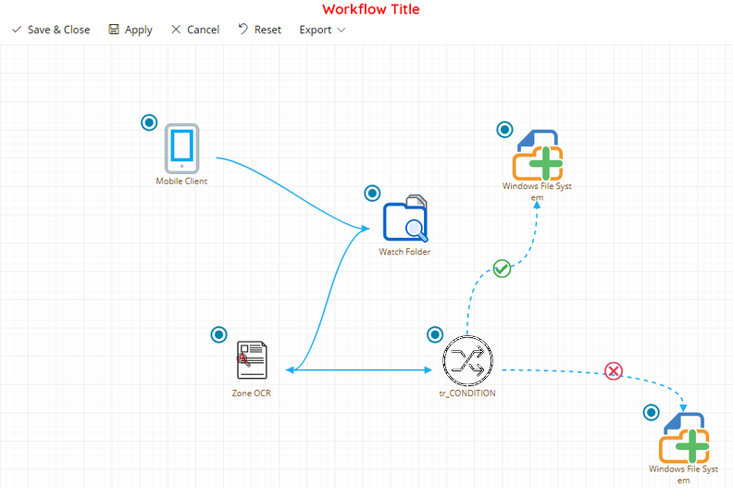
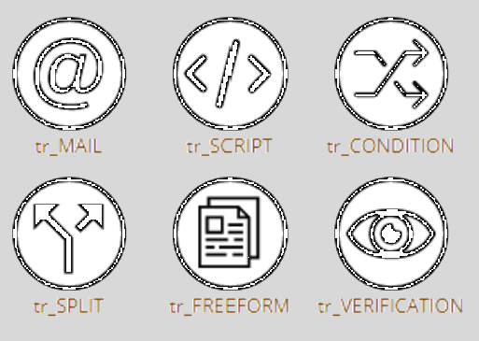
Document Navigator Triggers
Process Workflow Management
Notes:
Triggers can be added to the capture workflow to enhance the overall design of the workflow;
Included in Document Navigator: Email Trigger. This can be added at different points within the workflow to enable a notification email to be sent to the end user or a nominated end user to resolve exceptions.
Purchase of development required: Script Trigger. Scripts can be added at different points within the workflow to enhance the functionality of the workflow such as taking the captured data from a barcode process to then perform a SQL database query to return additional information (not present within the document content) to use later in the workflow to (1) identify the route to store the document, (2) name the document, or (3) add data to back office systems as index date (MetaData), or a combination of all of these options.
Included in Document Navigator: Condition Trigger. This is a logic step (true / false) query where typically we test data that has been captured, to then drive the document down a particular process route. An example of this is to test purchase invoice suppliers to then pass a particular supplier down a desired workflow process task.
Included in Document Navigator: Split Trigger. This enables a document to be split at a particular step within the workflow based on number of pages.
Additional Purchase Required: Freeform Trigger (Document Recognition) is a service that identifies the layout of the document. For example Purchase Invoices typically use this trigger to break down the batch of supplier purchase invoices to output them to each supplier workflow process to process the purchase invoices further.
Additional Purchase Required: Verification Trigger is used where a multi step approval workflow is needed where one or more end users will perform a review of the document to approve or reject the document

Slide 15
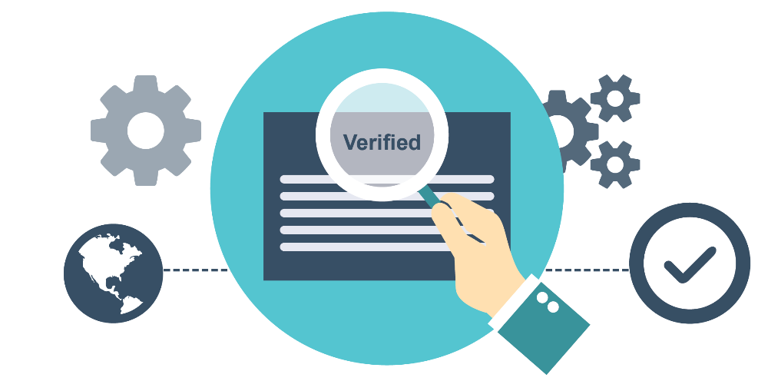
Document Navigator Workflow services
Content Migration, Integration, Collaboration
Migrate Content
Via
Dynamic Integration
Collaboration
Notes:
This is an example of Content Migration, Integration and Collaboration where the Verification Module is being used where end users will review and collaborate on documents to finally approve the document to in this example store the document to SharePoint. Unless all staff involved in this workflow process approve the document, the document will not be stored to SharePoint until all queries have been resolved.

Slide 16
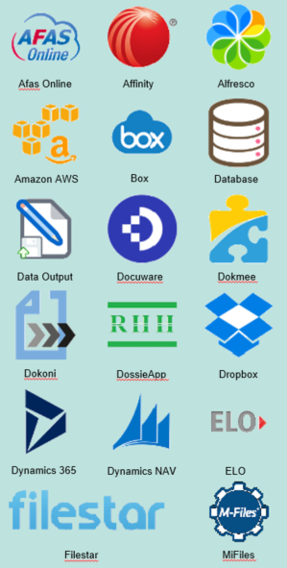
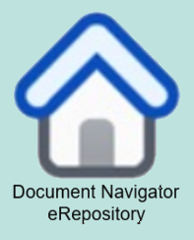
Document Navigator Store Connectors
Store
{
Document Navigator Process Server
Notes:
Document Navigator has a large number of back office system connectors that potentially your customers may use one or more of those connectors to enable staff to easily and securely scan documents straight to those systems right from the MFD. As this presentation is around Document Navigator and Filestar. In this instance the documents could be scanned to Filestar
These connectors (excluding the default connectors mentioned earlier) need to be purchased.

Slide 17
Filestar Document Management
Introduction to Filestar Document Management
Notes:
The following section of this presentation I will discuss how the Filestar Cloud Pro Features and Functions map to the DX processes that I talked about in previous slides

Slide 18
About Filestar
Software Developer for nearly 25 years.
UK product owned & developed by us.
Filestar On Premise launched in 2008.
Filestar Cloud launched in 2012.
Cloud now accounts for 100% of sales.
Using Microsoft Azure platform since 2020.
Started working with Kyocera in 2017
Started working with Konica Minolta in 2019
Customers vary in size (5 user to 500) but no max.
Majority of systems are scan & archive.
Electronic Documents? Office add-ins are available
Zonal OCR, barcode & QR Code recognition options
Can accommodate bespoke workflows.
Notes:
History of the Filestar company and solution.
Although Filestar has an on premise version we have never sold this application as 100% of our sales to date are Filestar Cloud Pro, and I don’t anticipate the need to sell the on premise Filestar application.
There is a good chance that over the next 12 to 24 months that the on premise application will disappear of the price list

Slide 19
Product Positioning
100k-250k
25k- 100k
Price
0k- 25 k
Features
Notes:
The above graph positions Filestar against its competition to also highlight that it has excellent features at an excellent price point, making Filestar an ideal solution for the SMB / SME market share where it would be a struggle to sell the likes of M-Files or DocuWare into.

Slide 20
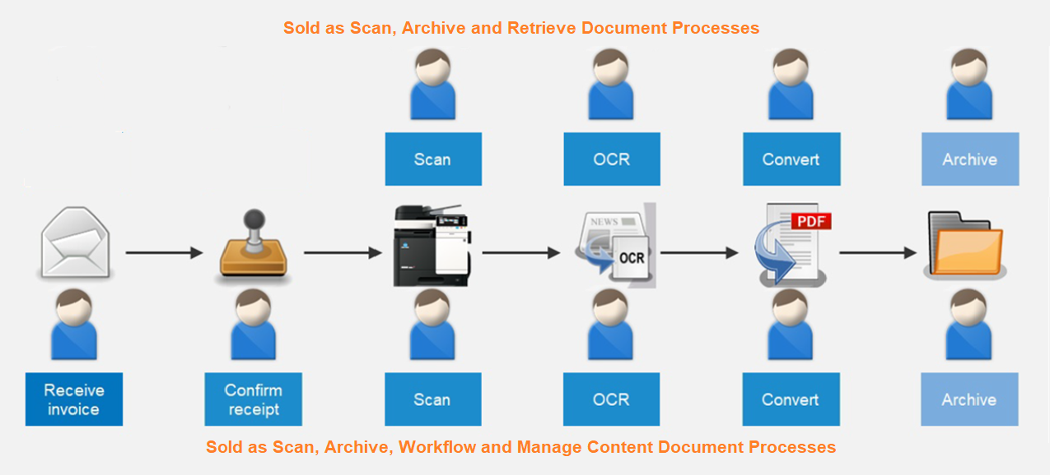
Product Positioning
There are two typical sales options with Filestar.
The following is a graphical representation.
Notes:
This slide is an extension of the original slide presented earlier where we position the two typical sales scenarios
Scan, Archive and Retrieve. This scenario makes up for 80% of our sales of Filestar where customers just want to scan their paper-based documents and store their electronic files to securely archive them where possibly at some point in the future they may need to search and retrieve them, but with the knowledge that the information is secure and easily searched for.
Scan, Archive, Workflow and Content Management. This scenario is for specific departments or business’s that have processes around their documents that need interaction for a specific period of time from inception to review and collaboration to finally archiving the document for future search and retrieval at some point in the future.

Slide 21
SOME Filestar Customers
Notes:
This slide is an example of some of the direct Filestar customers. Filestar has been sold to resolve a particular departments document management requirements and in some instances have other document management systems in place that they could have used, but due to budgeting demands when adding extra users and storage, this option was not viable, but Filestar proved to be the best cost efficient solution.
We cannot list the indirect partner customers because we want to protect those partners accounts, but since launch of Filestar, we have now sold over 50 Filestar solutions and the list is growing monthly.

Slide 22
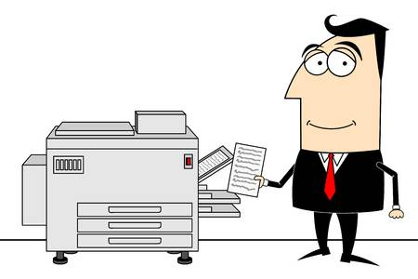
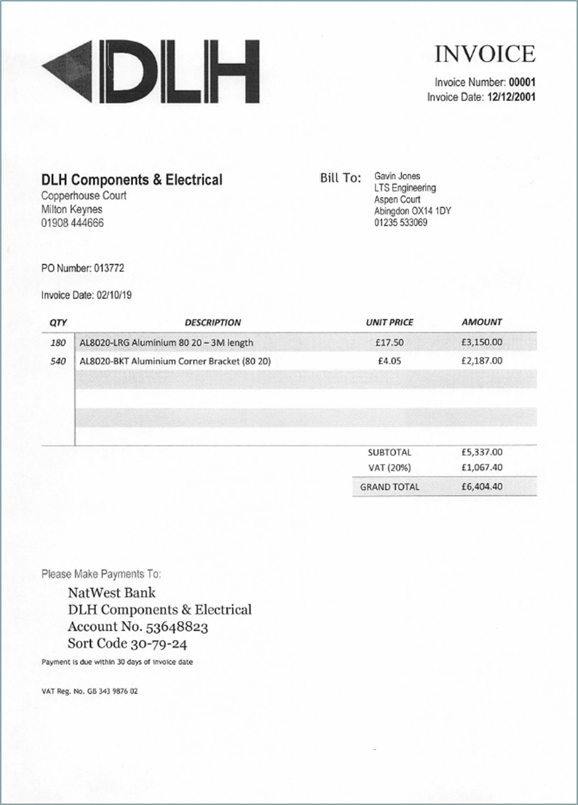
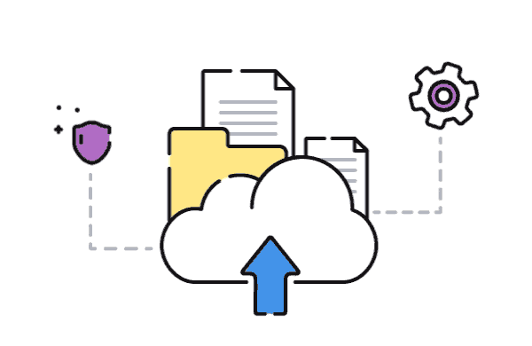
Standard Filestar Scan Process
SMB or FTP
FOLDER
Notes:
This slide represents the Filestar document capture process and is great for small to medium volumes of document scanning with some automate barcode or OCR engine recognition.
However, for more complex scanning requirements and the need to perform some clever batch scanning processes, you could elect to sell a Hybrid solution by adding Document Navigator to the solution where Document Navigator performs the advanced scanning and delivers the documents to Filestar for the management of those documents.

Slide 23
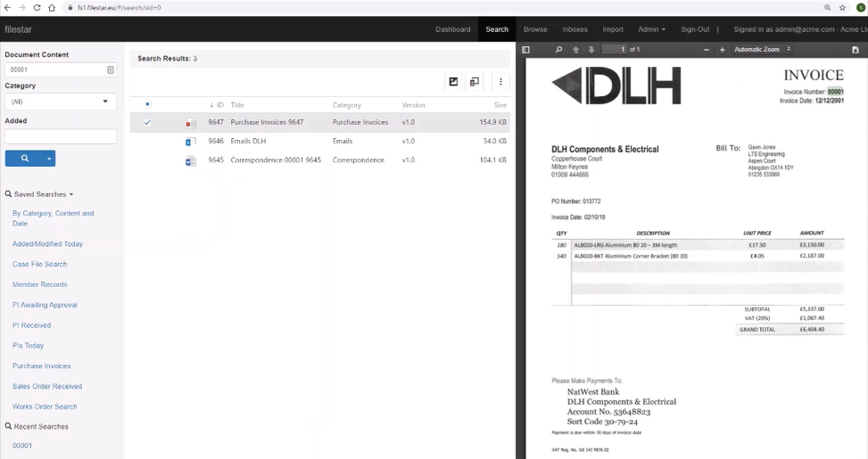
Filestar search & retrieve
Notes:
This slide is of a screenshot after the end user has performed a search which returned a number of document results in list form, and the end user selected a document in the list which opened up a preview of the document with the word that was searched for being highlighted in the document preview.

Slide 24
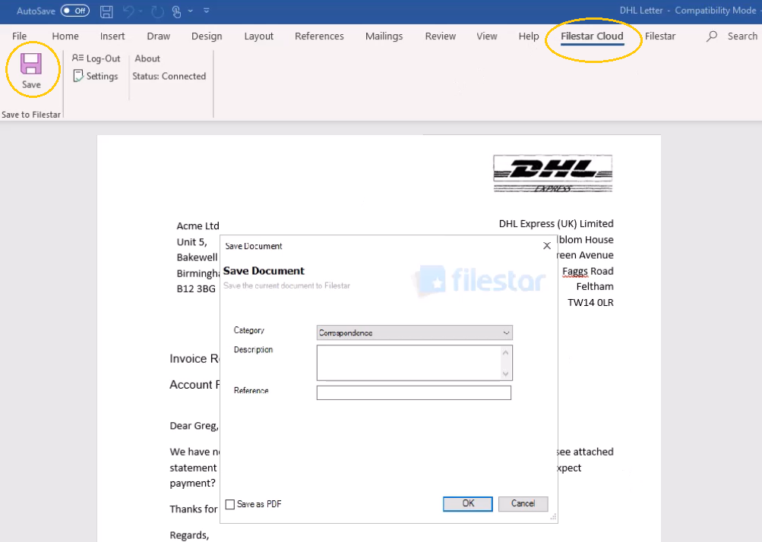
Filestar Microsoft Office Plugin
Notes:
So far, we have been talking about scanning documents into Filestar, but with the Microsoft Office Plugin, we also have the ability to store documents to Filestar straight from the Microsoft Office application by using the Filestar Office Plugin as shown in the screenshot above.

Slide 25
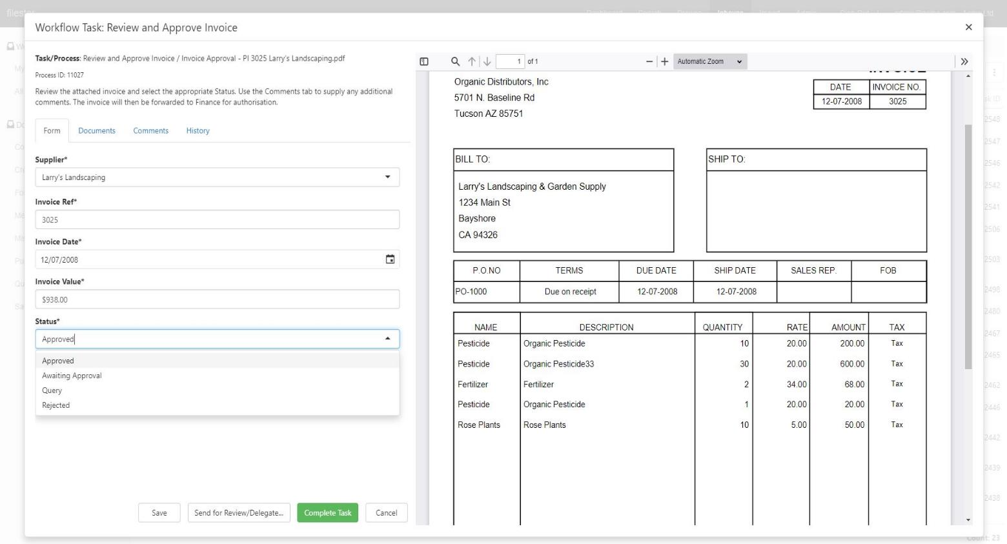
FILESTAR Accounts Payable Workflow
Notes:
Filestar has an optional Accounts Payable (AP) module that will process purchase invoices to capture the relevant data that the customer wishes to see and index this information into Filestar to be used through the purchase invoice approval process. A lot of solutions in the market place rely on invoice volumes to be from 3000 to 5000 invoices a month to generate a good Return on Investment. For Filestar this could be from 1500 invoices per month to show a good ROI.

Slide 26
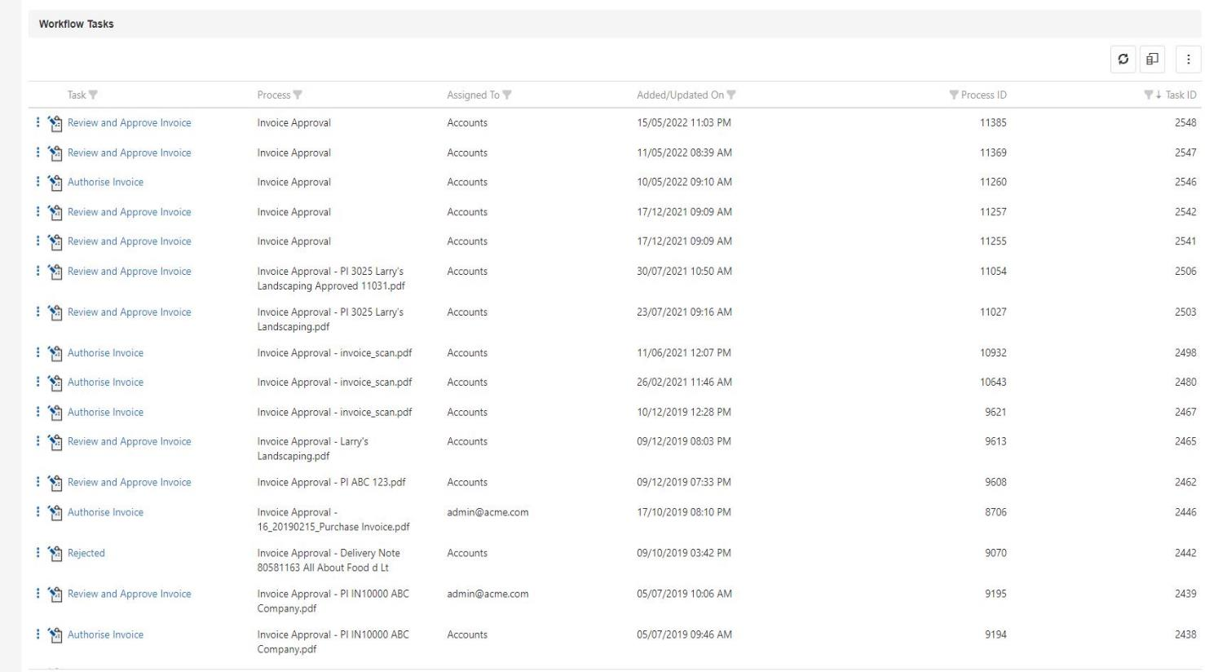
FILESTAR Accounts Payable Workflow
Notes:
This slide shows the Accounts Payable workflow task screen for the super user (other users may get a smaller view of the tasks dependent on their permissions) who can monitor the overall process or interact with the workflow directly to help process the invoices.

Slide 27
Benefits: Cloud document management
Accessibility.
Access anywhere, anytime.
No vpn’s or complicated connection issues.
Easy to provide your customers access.
Fast web based support
Infrastructure.
No strain on your internal I.T. systems.
No software updates.
No backups to do.
No pc or server software to install.
Microsoft Azure servers
Purchased 3 years in advance.
Simplicity, safety and security.
The simplest interface on the market today.
Climate controlled and Uninterruptible power.
24/7 security on-site.
Backup performed every day.
Redundant servers
Notes:
This slide demonstrates the benefits of purchasing a cloud hosted Document Management solution vs on premise.
One thing to take into consideration is to host a system on premise, there are hidden costs to be considered where the server has to be purchased and managed during its lifetime. IDC state a conservative cost per annum to purchase and managed a server is approx. £3,500 per year, and then add on the application and support costs and this starts to show why going cloud provides a good ROI.

Slide 28
Benefits: GDPR & Compliance
Fines – 4% Global turnover or €20 Million.
Notes:
Some businesses will store documents that have compliance wrapped around them or the business process has to be compliant. In the slide above, this shows examples of businesses that fell foul of this compliance and paid the penalty.
Filestar can help business.es with their compliance

Slide 29
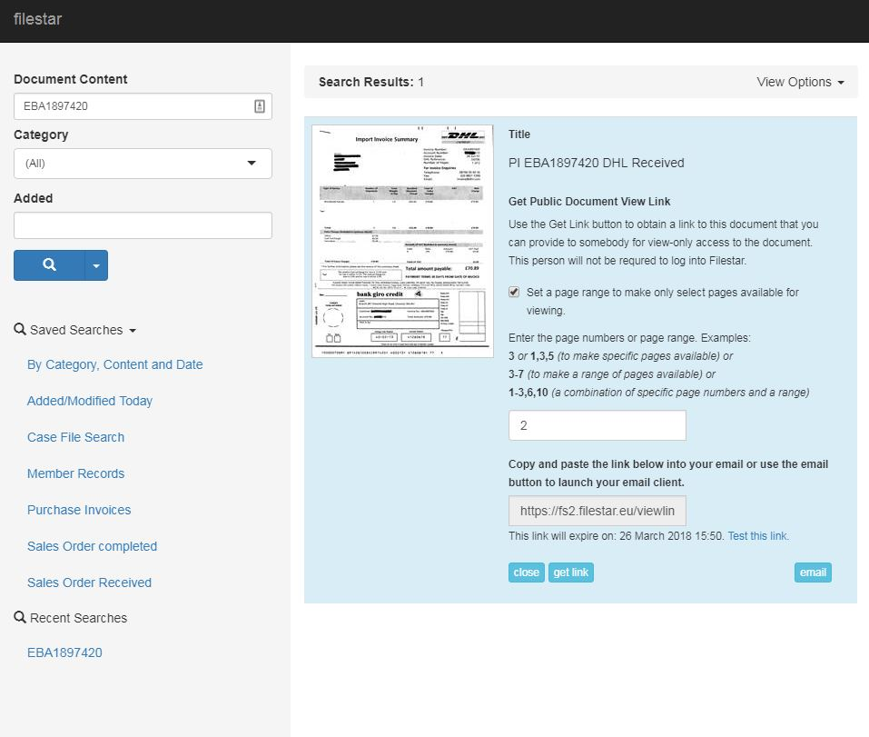
Benefits: Data Requests
Notes:
If the business receives a data protection or freedom of information request, there are set guidelines and timescales that need to be adhered to, to ensure the information is provided in a timely manner.
Filestar can help with searching and retrieving those documents easily and quickly, to then bundle them together as a compressed ZIP file to then share them securely with the requestor. This sharing can be password protected and time bombed to enhance the security further.
Can you imagine how hard it would be to search through filing cabinets, archive boxes (onsite and offsite) and level arch files for content that matches the requestors requests. And then how are you going to collate all this information to send to the requestor. This is a costly task for businesses to handle when documents are stored in this way rather than in a Document Management system like Filestar.

Slide 30
Benefits: Retention policies
Notes:
Part of compliance and legislation is documents are categorised into Document Types and each type has a legal timeframe from inception to destruction. Keeping documents beyond their legal timeframe without good reason can lead to fines being placed on the business.
Filestar can help with this at it has an inbuilt Retention Policy engine that will help the superuser identify documents for destruction and will automatically remove them from the search options for normal users enabling the superuser to confirm it is ok to delete completely.

Slide 31
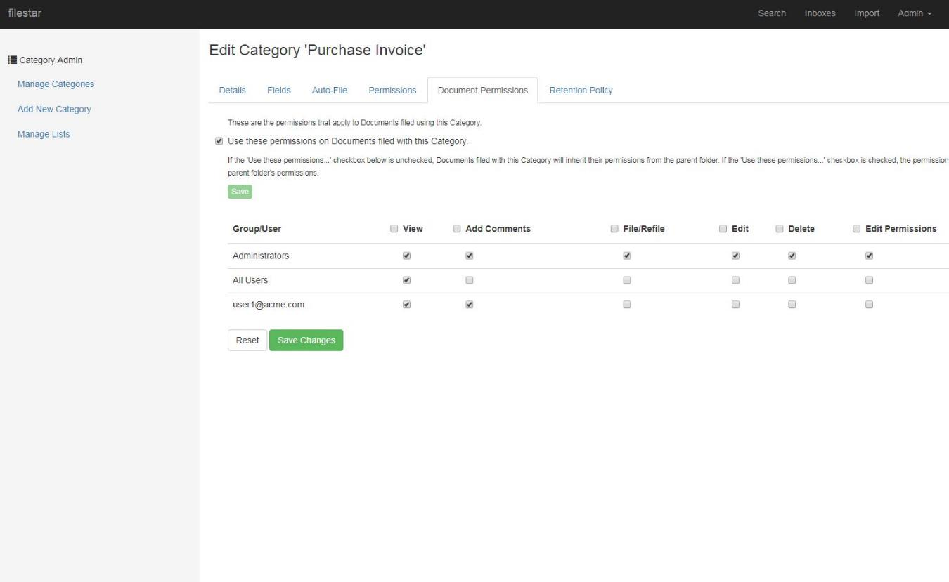
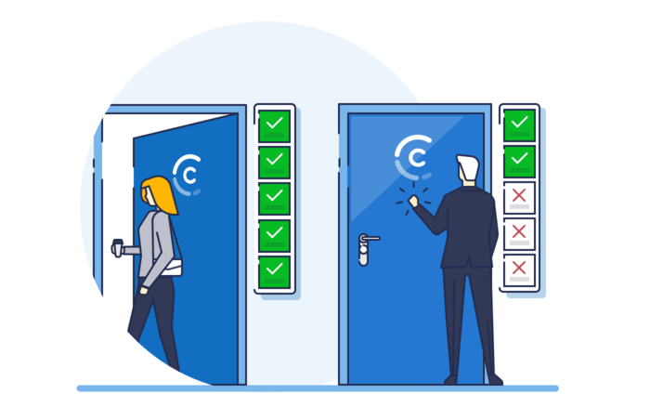
Benefits: Granular user permissions
Notes:
Compared to Microsoft OneDrive and a Fileserver, Filestar has a very granular level of security and the screenshot above is an example of how the permissions can be used.

Slide 32
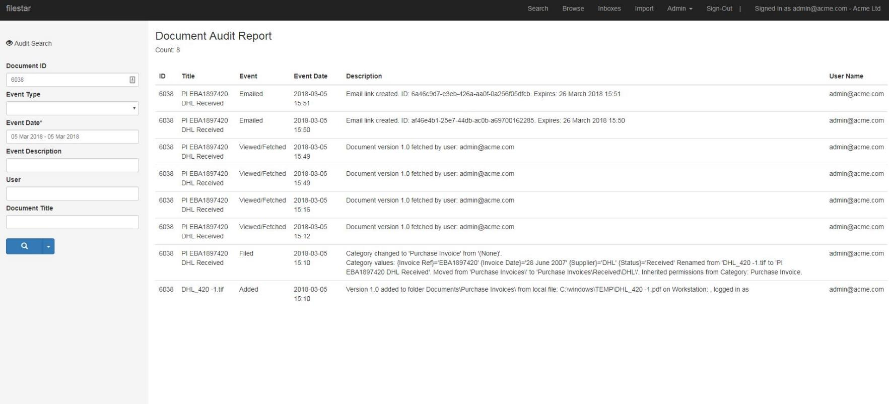
Benefits: Audit trail
Notes:
With respect to Document Security and Legal Admissibility, Filestar has a great Audit Trail that is read only and cannot be tampered with to prove who did what, when and where with respect to accessing the document and managing the document through its lifecycle

Slide 33
4 Step Sales Process
Product Introduction/Meeting.
Demonstration
Video’s
Quotation.
Free 2 Week Trial.
Close the Sale.
Benefits
No Gap in Customer engagement.
Shorter sales cycle.
Easier “sell”.
Deals with any issues pre-sale.
Notes:
Working with Filestar, we have proven through Prospect and Sales analysis that by offering a proof of concept as early as possible in the sales cycle that the conversion rate is far higher than going through the standard sales cycle, and we have also seen the overall sales cycle has been reduced to an average of 3 weeks compared to and average of 8 weeks for a normal sales approach

Slide 34
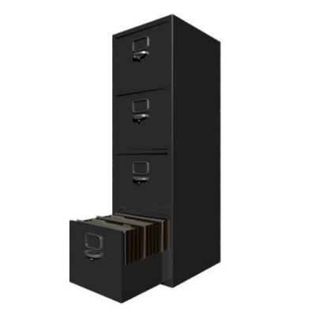
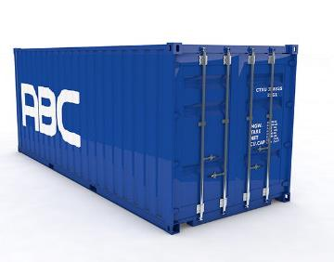
Customer questions
How is your information stored?
Filing cabinets
Storage boxes
Servers
PC’s
This means Information is fragmented around the business and not shared properly.
Where is it stored?
Premium office space
Warehouse
Containers onsite
Offsite storage
This can mean Space/money is being wasted.
Have you any specific document issues?
Compliance? GDPR?
Losing documents.
Too much time spent looking for documents.
Documents requiring signature are taking too long.
Is it about improving efficiency?
You can improve all of the above with Filestar.
Notes:
This slide show the typical customer questions we come across and can be used by salesman to look for opportunities to sell Filestar.
Any one of those questions is a hook to a sale, and the more you can tick off, the bigger the chance in securing the sale.

Slide 35
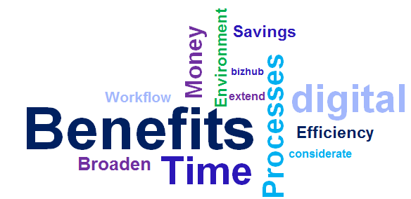
BENEFITS
PROFIT, EFFICIENTCIES & SAVINGS
Broaden the Opportunities of the Konica Minolta Bizhub MFP
Increase Reliability & Productivity Through Automated Tasks,
Efficient Search & Retrieval Practices
Avoid Mistakes Through Automated Workflow Usage
More Time to Focus on Main Responsibilities
Step Closer Towards the Paperless Office
Save Time & Reduce Costs
More Considerate to the Environment
Notes:
This final slide is a summary of all the content I have gone through, and highlights some key Benefits for selling Filestar

Slide 36
Thank you for listening – Questions
Contact: brett.lewis@konicaminolta.co.uk ¦ 07860753431

