Slide 1
Introducing Intuitive

Slide 2
Agenda
What is Intuitive
The market landscape
Introducing IntuitiveDX
What's in it for Resellers?
Demonstration

Slide 3
Working with you
Catherine Kennedy – Sales & Marketing Director
Catherine.kennedy@weareintuitive.com
Kieran Sherratt – Senior Sales Executive
Kieran.sherratt@weareintuitive.com
Notes:
Introductions

Slide 4
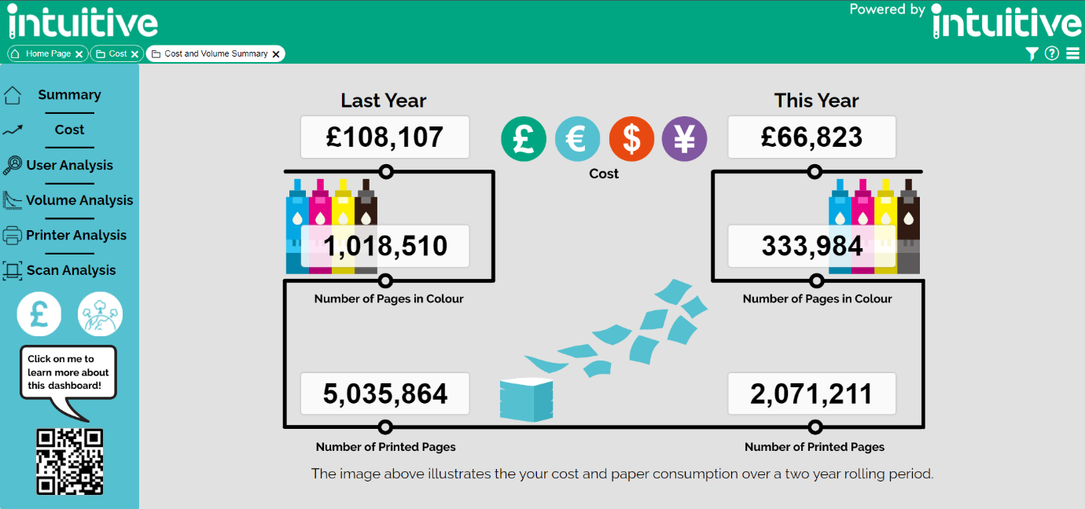
Print Management Analytics for PaperCut
Easy to use BI dashboards
Reconfigure the print estate
Eliminate inefficient user printing behaviour
Differentiate your offering in a mature market
Low cost, high margin solution with tangible benefits
Notes:
If you are not familiar with intuitive, let me tell you what it is…
Intuitive is a BI Dashboard add-on for PaperCut MF, which enhances Papercut's existing reports.
Intuitive for PaperCut provides a quick live view of your company printing in just a few simple clicks.
Helps to reduce printing costs by providing a simple view of your printing data. You can use this data to set up rules in PaperCut software, such as a prompt to print in B&W.
Intuitive for PaperCut is a prebuilt solution, which means it takes less than a day to install the basic configuration.

Slide 5
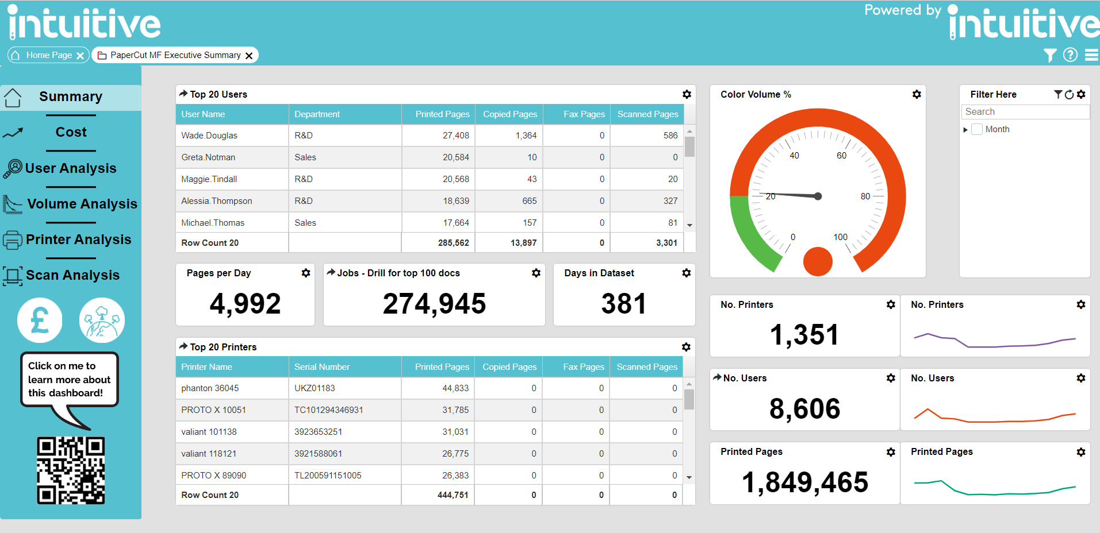
Notes:
This is Intuitive – you may be familiar with this view which includes 6 standard dashboards plus an environmental impact dashboard (following slide)
Intuitive takes the data from environments such as PaperCut and SafeQ and delivers a view to the end user which allows them to easily identify print hotspots and areas of waste in time and resources.

Slide 6
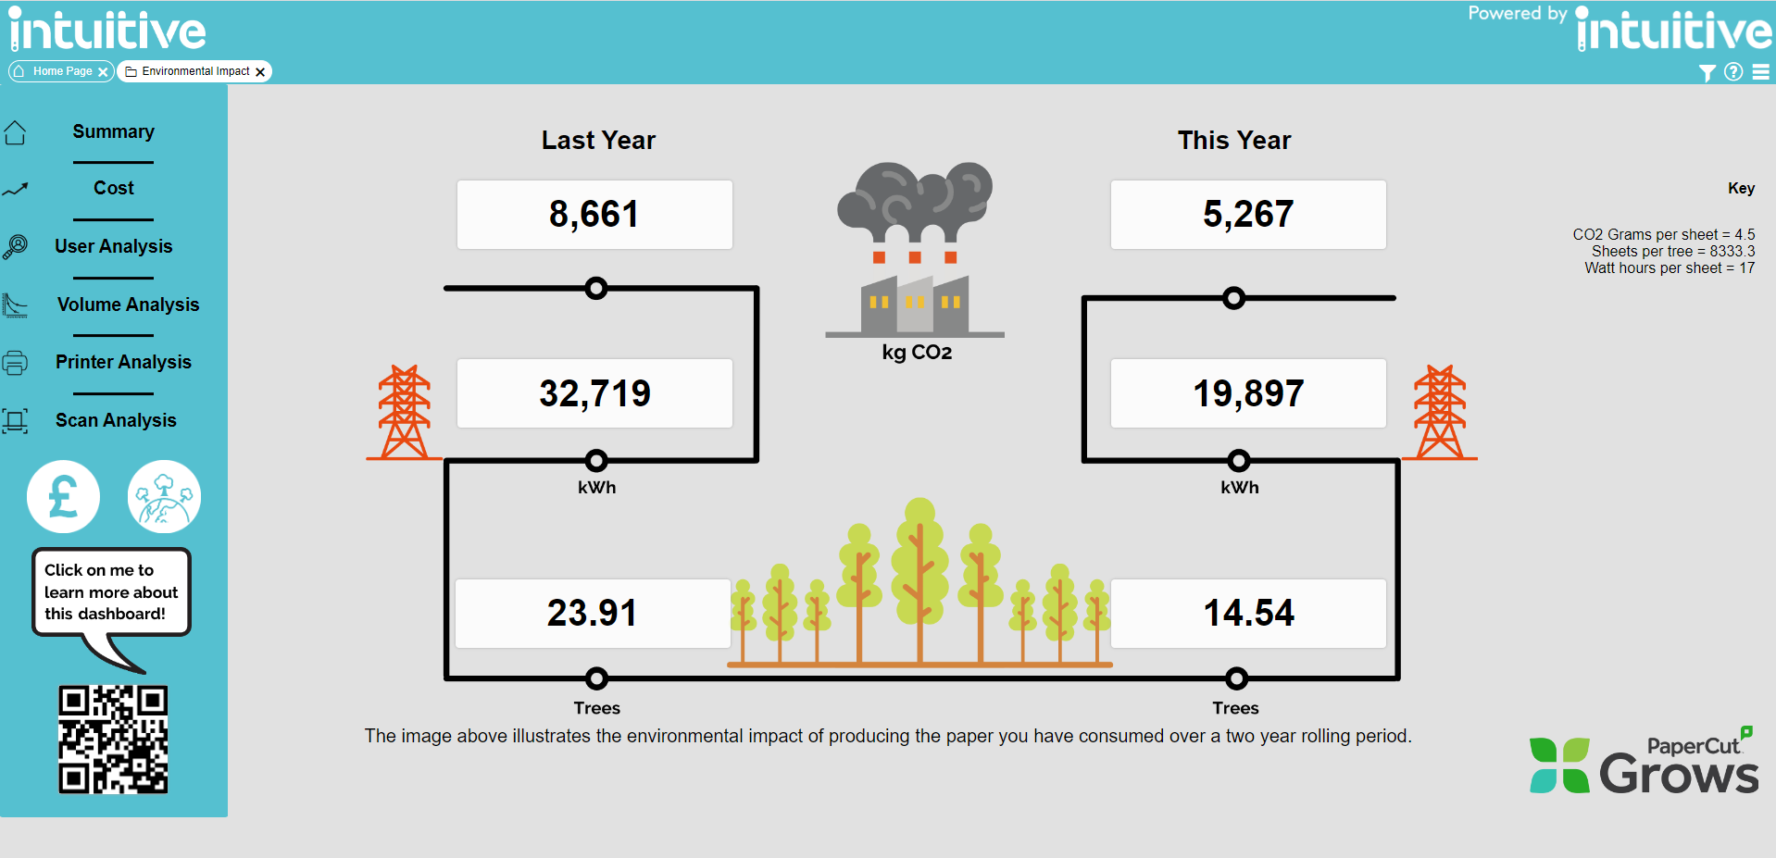
Notes:
The environmental impact dashboard displays usage over a two-year rolling period and features a link to PaperCut Grows for those customers who want to achieve carbon neutrality

Slide 7
Market Landscape
“Innovative use of data is key to unlocking new opportunities in an industry characterised by hardware commoditisation, declining print volumes and ongoing digital disruption”
Quocirca January 2023
Volumes​
Refresh rates​
Hybrid working​
New revenue streams?​
Transition from current portfolio to new products ​
Different decision makers for new solution
Notes:
By 2024, the average refresh cycle of a typical office workgroup MFP will be extended by 20% versus pre-pandemic time frames. (PaperCut)
Due to Hybrid working we find print volumes down and longer times between fleet refreshers
Therefore, we need to establish ways to be more than just a print supplier
Using Intuitive you can use the customer’s data to facilitate conversations on workplace processes and where time and resources are consumed
Then bridge the gap between their current portfolio and new products e.g. Umango

Slide 8
Intuitive six months results ….
Largest quarter in
The history of the company
Largest ½ year in the history of the company
2021/22 turnover exceeded after 27 weeks of 2022/23
150 Different
Customers
Notes:
Despite the market landscape…
Intuitive has had its Largest quarter in the history of the company, largest half year and recently the largest ever order which was 552 devices over 6 years

Slide 9
Konica Minolta…….
43,500 devices connected to either print or fleet Management Dashboards
Last 12 months
11,900 devices
98 customers
Approx £600k of SRP
£2,000,000 lifetime
SRP sales exceeded in Intuitive Software and Services
300 customers exceeded
Largest ever sale globally of print management dashboards
Notes:
Similarly, KM has had great success

Slide 10
How do we maximise our advantage?
Sell the dashboards as part of your customer engagement
Analyse the data for your customers as part of your service offering
Identify opportunities to innovate and sell new solutions
Notes:
The 3-step approach we recommend , and have trialled with several customers is:
Sell dashboards as part of initial engagement - once installed and presenting data...
Sell consultancy to investigate areas in more detail – this would involve working with the customer to analyse the data in more depth (don’t forget to include scanning and copying data too)
Use the data in the dashboards to identify other opportunities to innovate and provide solutions for digital transformation. e.g. ECM and Process Automation
Opens the door to other solution sales such as IVS

Slide 11
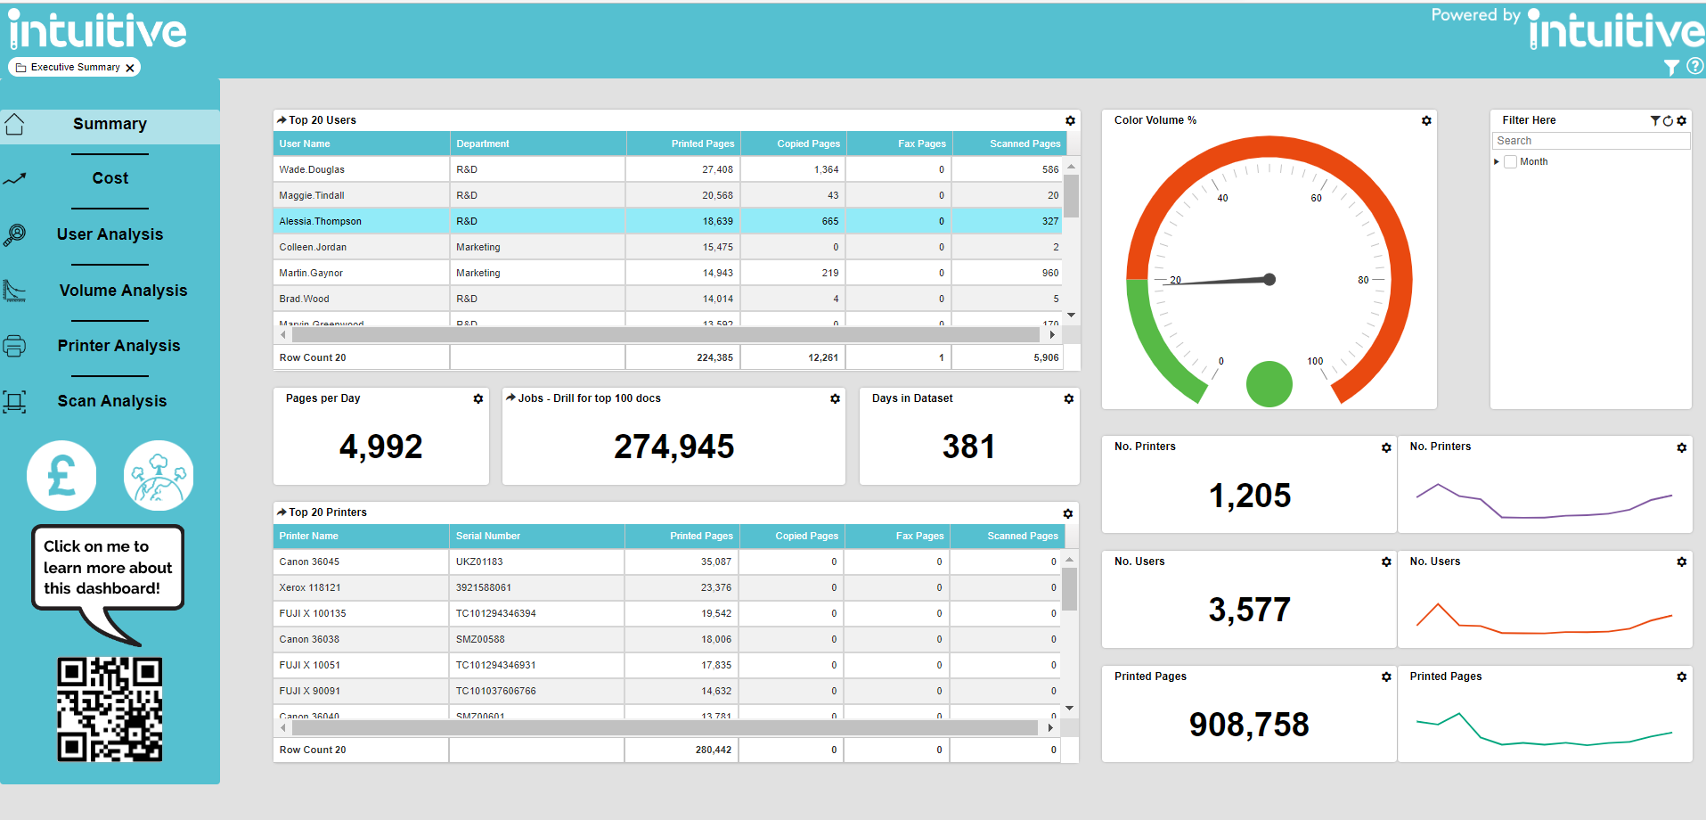
Embedding Dashboards into Sale
New Business
Renewals
Strategic Accounts
(pre tender)
Notes:
Success is a result of
A value added upsell for existing and new business PaperCut clients
Can be added into upcoming PaperCut M&S renewals to increase order value
Additional differentiator for new business sales of PaperCut
We know that as people return to the office - volumes are going to change and fluctuate. Due to this rapid change there is more need for usage to be monitored.
Customers will start to demand more from resellers as the market becomes more competitive. And Intuitive can be a solution to this by spotting opportunities to innovate and a spring board to offering process automation solutions.

Slide 12
How to build more value
Print
Dashboards
Analyse
Data
Expand
Account
Print
Analyse
Expand Account
Deliver Intuitive
Print Management dashboards for quick implementation and benefits
Highlight expensive print hotspots
Reduce print costs
Identify manual processes that can be automated
Expand solutions out to other areas of the business e.g. ECM and Process Automation
Notes:
Intuitive can be used to open the conversation with the customer to analyze their data and provide solutions to their issues
Using intuitive we have been able to identify workplace processes which lack efficiency and take time away from staff

Slide 13
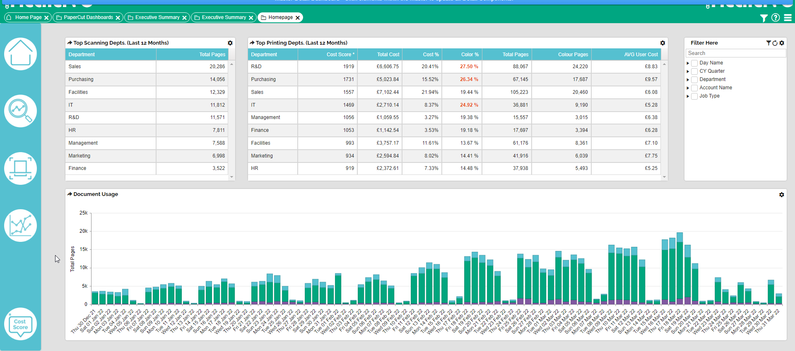
Intuitive DX
A new set of dashboards
Designed for resellers to deliver additional value to their customers
Easy to highlight opportunities for digital transformation
Free of charge
Notes:
And we created a toll to assist in just that
Intuitive is a BI Dashboard add on for PaperCut MF, which enhances Papercut's existing reports.
Intuitive for PaperCut provides a quick live view of your companies printing in just a few simple clicks.
Helps to reduce printing costs by providing a simple view of your printing data. You can use this data to set up rules in PaperCut software, such as a prompt to print in B&W.
Intuitive for PaperCut is a prebuilt solution, which means it takes less than a day to install the basic configuration.

Slide 14
What we provide...
Four pre-built dashboards that use existing Intuitive for PaperCut data
New ways of navigating through print data, with more powerful and deeper analysis of user behaviour
Consistent look and feel – uses Intuitive’s dashboard styling that users are familiar with
Identifies areas for improved productivity, efficiency and potential savings of your customers processes that can lead to opportunities of digital document processing
Notes:
In addition to the 6 Dashboard views Intuitive provides to the end user we have also created Intuitive DX, an additional tool for you the reseller/partner to use
4 Pre-built dashboards that use existing data to identify pain points with your end customer, identify areas to improve productivity, efficiency and potential savings via digital document processing

Slide 15
Is this right for you?
Already selling PaperCut
Interested in growing new revenues streams outside of traditional print
Consultative / solution selling approach
Notes:
PaperCut and Intuitive go hand in hand, if you are selling PaperCut then use Intuitive as the tool to increase your revenue and achieve a consultive selling approach

Slide 16
Why use Intuitive Instead of PowerBI?
 | Intuitive | PowerBI
Price | £13.50 per device per year | Around £4,000 per month (corporate licence)
Design | Delivers out of the box dashboards | Requires BI knowledge/ BI expert
Data Management | Understands PaperCut MF data and has built-in ETL | Limited ability to manage large data
Implementation | Less than half a day to implement | Around 15-20 days of implementation
Pre-Built | 8 out of the box pre-built dashboards | Nothing pre-built in PowerBI
Notes:
Within the world of dashboards, PowerBI is arguably the most well known product there is on the market, as it is owned by Microsoft.
When we start to compare the likes of PowerBI and Intuitive, we can start to uncover so very noticeable differences. We find that the most clear ones are:

Slide 17
Summary
Additional tool to be used in partnership with customers
Part of QBR or a separate meeting
Opportunity to move the conversation into new areas with new decision makers
30 minute install for current Intuitive Customers
Notes:
Intuitive can be an additional tool to be used in partnership with customers, for example as a QBR or separate meeting
Intuitive DX is a 30-minute install for current Intuitive customers

Slide 18
Intuitive DX Summary Dashboard - demo
Overview of the top departments’ volumes over the last 12 months
Detailed Document Usage breakdown of all activities over the last 90 days.
Drill into the Document Usage component to show the jobs performed on that given day.
Drill into a single department to show a filtered view on the 90 Day Analysis dashboard.
Our “Cost Score” metric helps to identify notable departments for investigation.
*Cost Score is a weighted metric of the overall cost, colour % of their printing, and the average user cost.
Notes:
*Kieran

Slide 19
What to do Next
Sales Certification (if not already completed)– V3.0
Identify target accounts
Include Intuitive in upcoming renewals and deals
Pre-seed into accounts coming to market/tender
Use our 40-day free trial where appropriate
Intuitive to support on demos– ask us any questions!
Utilise our Partner Portal
My Contact Details
Kieran.Sherratt@weareintuitive.com
Catherine.Kennedy@weareintuitive.com

Slide 20
Questions?

