Slide 1

KONICA MINOLTA OUTSOURCING

Slide 2
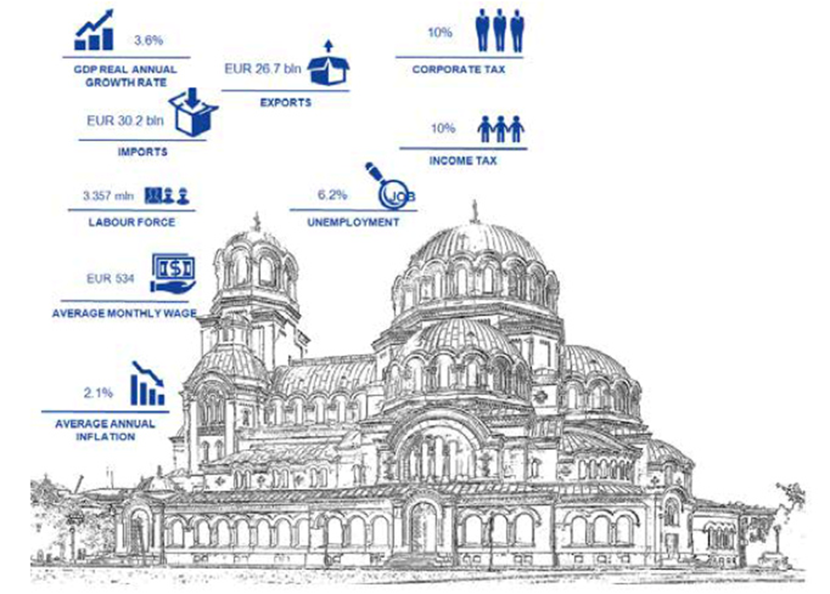

Bulgaria
Member of the European Union and NATO​
1 to 3 hours from anywhere in EU​
Culturally and linguistically aligned to the western business world​
Well-developed educational system (especially IT)​
98% of students speak one foreign language​
73% of students speak two foreign languages​

Slide 3
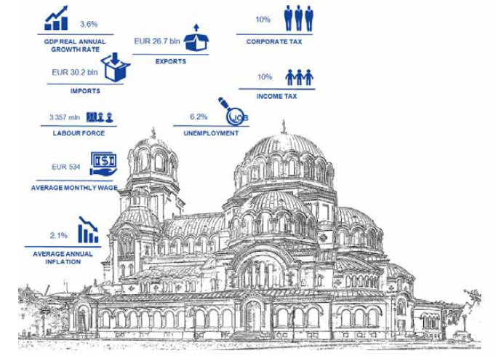
Bulgaria as an Outsourcing Destination
More than 2,200 students graduate in computer science each year. ​
2nd Most Attractive Outsourcing Destination in Europe
17th Most Attractive Outsourcing Destination in the World
Stable Business Environment – currency pegged to the Euro
Attractive Personal and Corporate Taxes
Lowest operations costs in the region
Mature outsourcing destination
According to A.T. Kearney’s Global Services Location Index 2021:

Slide 4
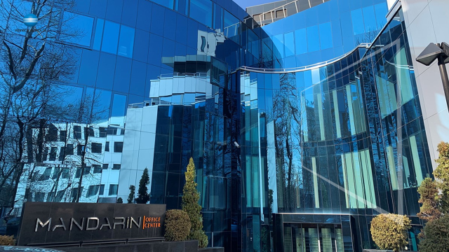
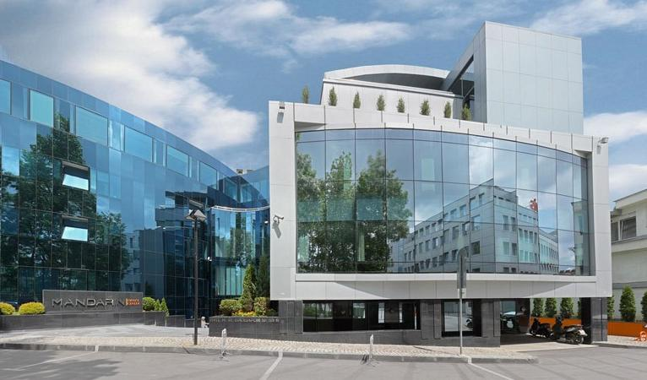
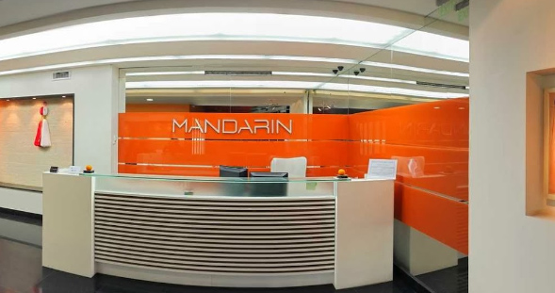
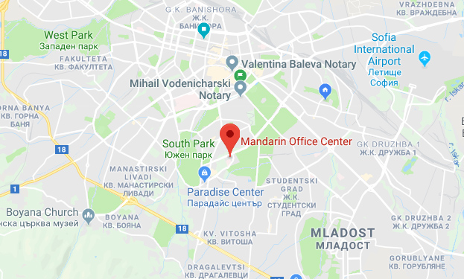
OUR OFFICE IN SOFIA – CAPITAL OF BULGARIA
2-3 hours
from London

Slide 5
Our value creation
Software Supply, Inside Sales & Marketing
UK Field Agents Work Schedules
Finance, Credit Control, Accounts Receivable
Client Services & Project Management
Supplier Procurement & Contract Renewals
2-3 hours
from London
MITS Internal Team
Help Desks (OnBase,
Alchemy), Development
Fax and Print, Unified Comms, SMS Help Desks
Outsourcing Marketing & SEO
Channel Partner Management: Fax & Print, Unified Comms, SMS
Solutions & Services: Inside Sales Software

Slide 6

Service Offering

Slide 7
Team Extension
Your Agents are Your Agents – Just in Bulgaria!
The Customer
  Onboard and train team members
  Manage agents’ time and workload
  Decide what software and tools they use
  Day-to-day management
  Treat them as an extension to their core team
Us
  Recruit and hire to brief
  Provide desks, equipment, tools, conference facilities, and IT support
  Take care of HR, payroll, legal, admin, holiday and sick leave
Recruit & Hire
HR, Admin and Legal Support
Equipment, Tools and IT Support
Team Building

Slide 8

comprehensive Skillset Breakdown
TECH DESKS
MULTILINGUAL TEAMS
SOFTWARE DEVELOPERS
CUSTOMER SERVICE
Customer Support
Technical Support
Log & Refer via Chat
Email and call handling
24/7 Desk
English
German
French
Italian
Spanish
Front-end
.NET
Java & JVM
Python & Django
Android (and more)
High Touch Support
Social Media
Lead Generation
Email Marketing
Data Entry
Website Admin

Slide 9

Simple
Contracts
Easy point of entry (1 Team Member)
Flexible Contracts
Fixed price
No hidden fees

Slide 10
SCALABILITY
Teams grow with success

Slide 11

COST
EFFECTIVENESS
Up to 20% cost saving
Significantly reduced overhead costs
Freed up resource
We take care of everything for a fixed monthly fee

Slide 12

How it works

Slide 13
RECRUITMENT PROCESS
Agent Hired and Onboarded
Final Interviews with Customer
CV screening & Shortlisting of Candidates
Job Brief Discussion & Advertise Vacancy

Slide 14





SAMPLE customers
Invoice Processing Platform in Denmark
24 Agent Data Handling Agents
Moved from Bangladesh
GDPR and Accuracy issues
Online photo printing company
28 Agents
Customer Support and advise
5 years and counting
AirBnB Hosts- London
10 Agents
Customers Service
Start-up
Hospitality – Temps - London
9 Agents
Customers Service
French Company
Sell and Support thousands of software applications
25 agents
Customer Support

Slide 15

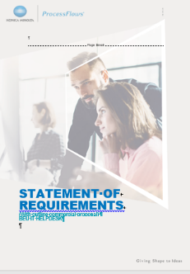
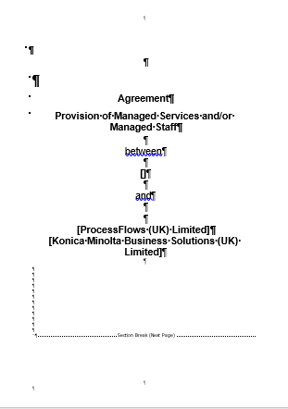






CONTENT COMPLETE
Customer Brochure
Customer Presentation
SOR
PF & KM
Contract
CASE STUDIES

Slide 16
QUESTIONS

